Slide 1

DEPARTMENT OF COMPUTER SCIENCE
II Project Presentation (KCS 753)
Cloud Hosted IP-PBX Phone System
Guide Name : Ms. Akanksha
Project Members
1.Rupesh Kumar - 2100290129008
2.Yash Surya - 2000290120198
3.Vinay Kumar - 2000290120191

Slide 2
Problem Statement
Nowadays the PBX (Private Branch Exchange) system is used in many business organizations, Hotels, and Institutions etc. for voice communication.
So, we are replacing the PBX system with Cloud based IP - PBX phone system for the use of voice communication inside the business enterprises, Residence and Hotels etc.

Slide 3
Objectives
To develop a cloud-hosted phone system using Asterisk that enables users to make and receive calls inside any organization with an internet connection.
To reduce the hardware and connection of extensions cost and also increases the scalability of the project.
Work with IP Phones along with softphones on different devices like PC, Mobiles and VoIP phones.

Slide 4
Technology Used
• VoIP or Softphone
A VoIP phone is a hardware - or software-based telephone designed to use voice over Internet Protocol (VoIP) technology to send and receive phone calls over an IP network.
• Asterisk Server
Asterisk is an open-source framework for building communications applications.
Asterisk turns an ordinary computer into a communications server. Asterisk powers IP PBX systems, VoIP gateways, conference servers and other custom solutions.

Slide 5
• Cloud Based Ubuntu Machine
Ubuntu Server is a server operating system, developed by Canonical and open-source programmers around the world, that works with nearly any hardware or virtualization platform.
• SIP
SIP stands for Session Initiation Protocol. The Session Initiation Protocol (SIP) is a signaling protocol used for initiating, maintaining, and terminating communication sessions that include voice, video, and messaging applications.

Slide 6
Literature Survey
Paper Title : Implementation of an IP Telephonic System on Asterisk PBX
Author Name : Abubakr Siddique Muntaka, Faiza Hussein, Paul Sarfo
Journal Name : International Journal of Computer Applications
Year of Publishing : 2019

Slide 7
Summary
In the research paper author Muntaka, Siddique Abubakr states that he research project aimed at creating a communication system to enhance campus communication.
Testing the system reveals that communication over the wireless network was successful with relatively some appreciable level of delay as the number of client connected to the Asterisk PBX Server increases. The delay was understandable since the prototype used Raspberry pi which comes with a limited computing resources. The call quality was however very good. The researchers further enhanced the setup by integrating the system with public switch telephone networks in Ghana like Vodafone, MTN, Tigo, Airtel, etc. This was achieved with Huawei USB Modern. This research project was very difficult, especially since the system is Linux-based. The main objective was achieved and the results were satisfactory

Slide 8
Paper Title : VoIP without without SIM calling using Raspberry Pi
Author Name : Megha S Meshram, Pooja Thakare, Pranali Dandekar
Journal Name : International Journal of Advance Research and Development
Year of Publishing : 2020

Slide 9
Summary
In research paper author Meshram etal. Megha S., Pooja Thakare, and Pranali Dandekar States that e IPPBX system utilizes organizational features such as call routing, music on hold, voicemail, and audio conferencing. Reduce cabling costs by using your existing network infrastructure. Setting up a softphone is easy. It is also flexible not only for users but also for administrators. Creating and removing extensions is easy. The nature of communication in a global world is an area of growing interest as people increasingly become relays on the Internet. Voice over Internet Protocol (VOIP) is this case and has become the most useful technology for long distance communication. VoIP is a rapidly growing technology on IP networks and is a time sensitive application, requiring real-time support. His VoIP over IP network is designed for data communication, but achieving reliable, high-quality voice over IP networks is a technical challenge. Designing a high-quality his VoIP implementation on the Asterisk PBX system requires choosing the best codecs and applying perfect techniques.

Slide 10
Ref. No. | Year | Paper Title | Authors | Major Findings | Limitations
[1] | 2019 | Implementation of an IP Telephony System Based on Asterisk PBX; A Case Study of Garden City University | Siddique Abubakr Muntaka Faiza Hussein Paul Sarfo | Created Communication System Works on Raspberry Pi device | Delay in Calls when number of clients increased
[2] | 2018 | VoIP without SIM calling system using Raspberry Pi for the small business organization | Megha S Meshram Pooja Thakare Pranali Dandekar | VoIP calling using Raspberry Pi Communication System for Small business Organization | Required Raspberry Pi as a Hardware device.
[3] | 2022 | Cloud-Based Phone System | Ahmed J. Aleissa Sabri N. Shabib Raied K. Farrash | Cloud based phone system using AWS as a cloud provider. Using 3CX as an asterisk | 3CX is not an open-source project. AWS is costly

Slide 11
Ref. No. | Year | Paper Title | Authors | Major Findings | Limitations
[4] | 2017 | Design and Configuration of VoIP based PBX using Asterisk server and OPNET platform | Sarwar Khan Nouman Sadiq | Test the configuration of VoIP based PBX on campus network. | Used on premise PBX system.
[5] | 2022 | Low Cost VOIP System Incorporation with Raspberry Pi | Nikitha Reddy Nalla Sakthivel S Shankar R | Low-cost voice system using Raspberry Pi | Raspberry Pi used as a server. Cannot handle large number of calls.
[6] | 2020 | Research and Development of an IP network model based on PBX Asterisk on the Opnet Modeler simulation package | Sergey Konshin Nishanbayev T.N. | Asterisk IP-PBX simulation to check the packets in the simulation. | Only checking the performance in OPNET

Slide 12
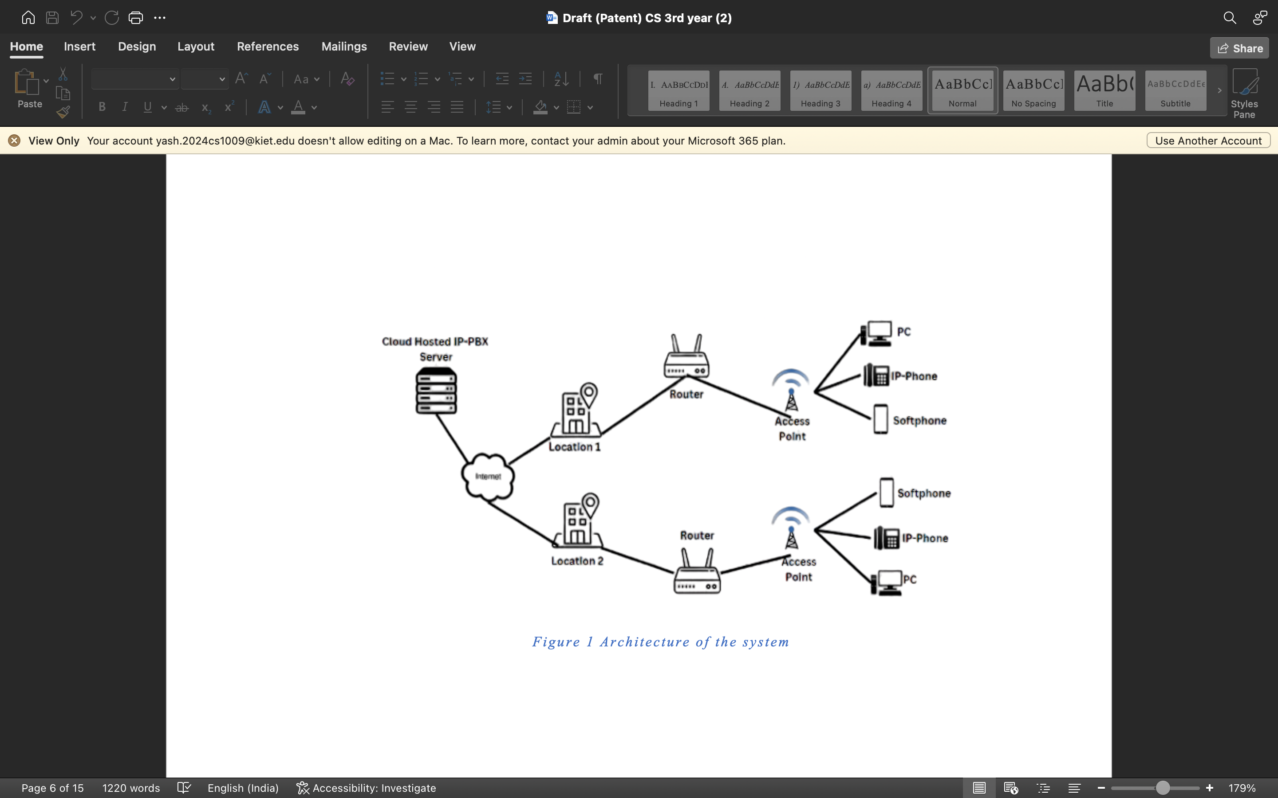
Diagrams
Diagrams

Slide 13
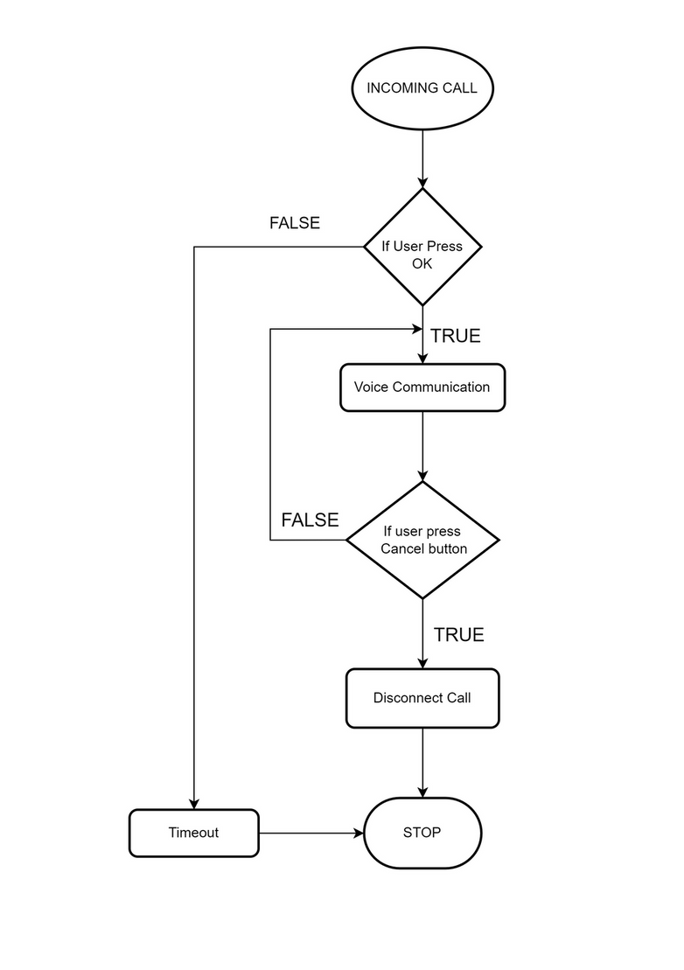
Flowchart of Incoming Call

Slide 14
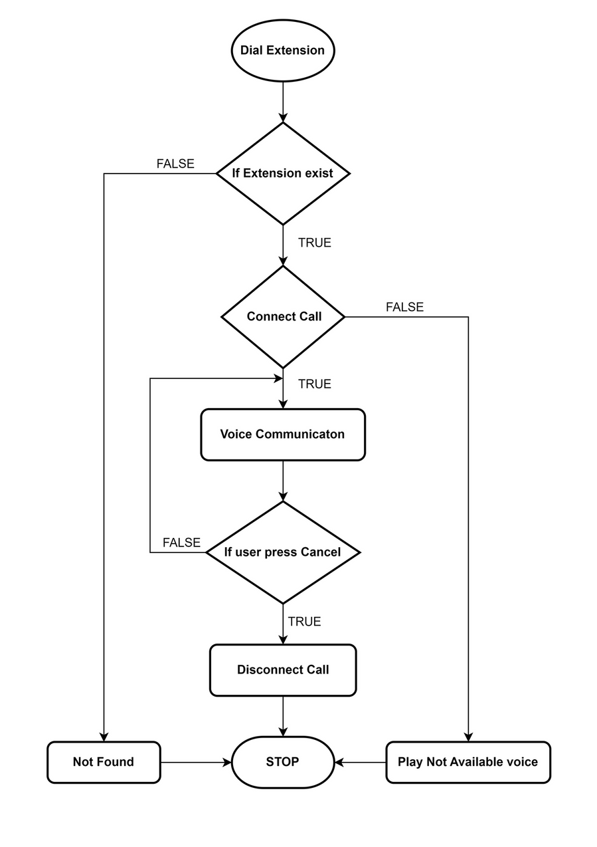
Flowchart of Outgoing Call

Slide 15
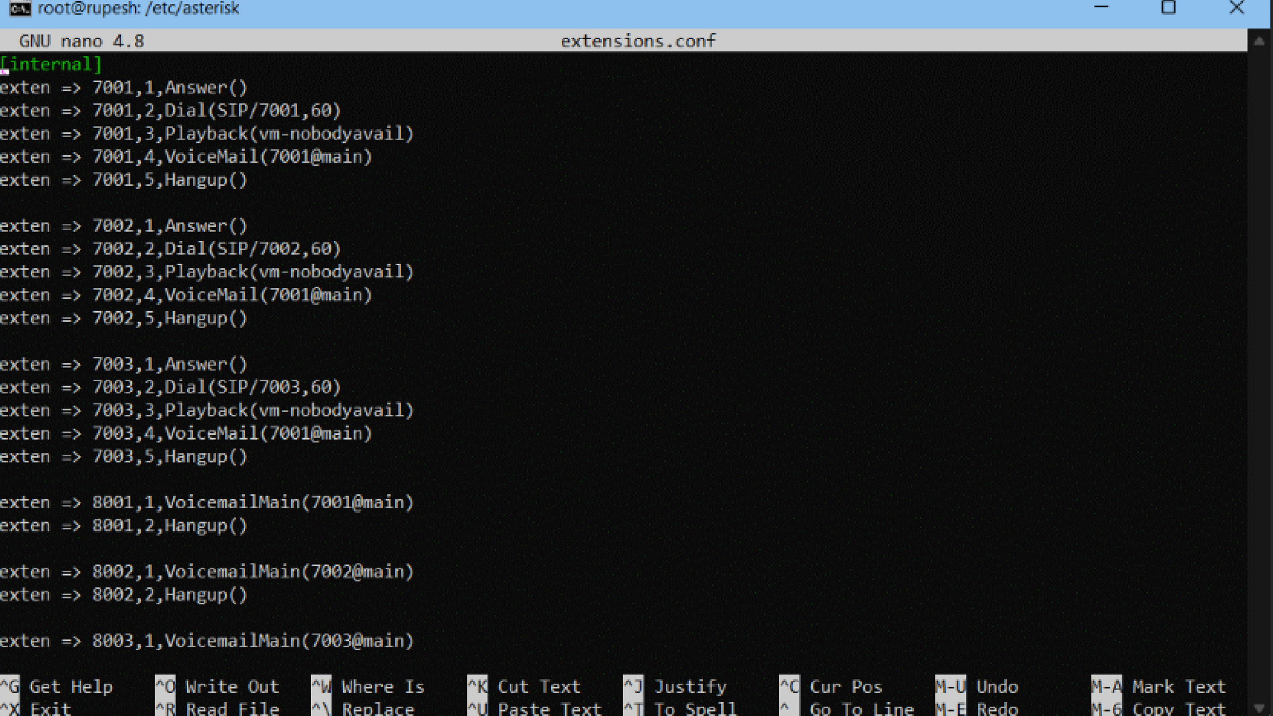

Slide 16
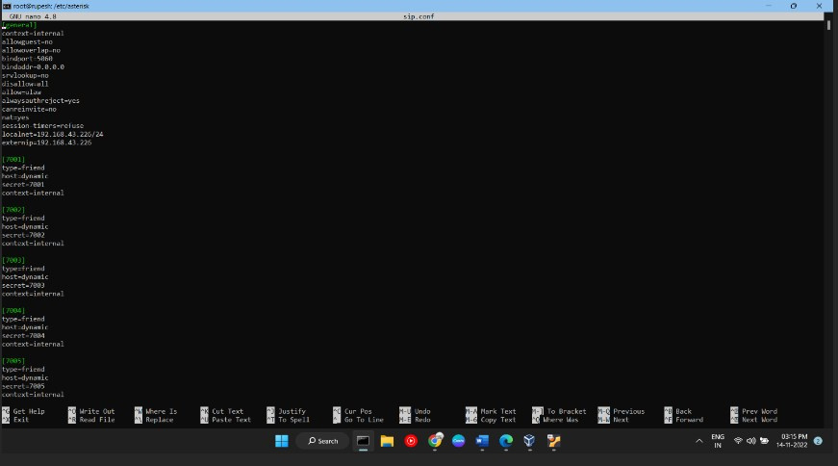

Slide 17
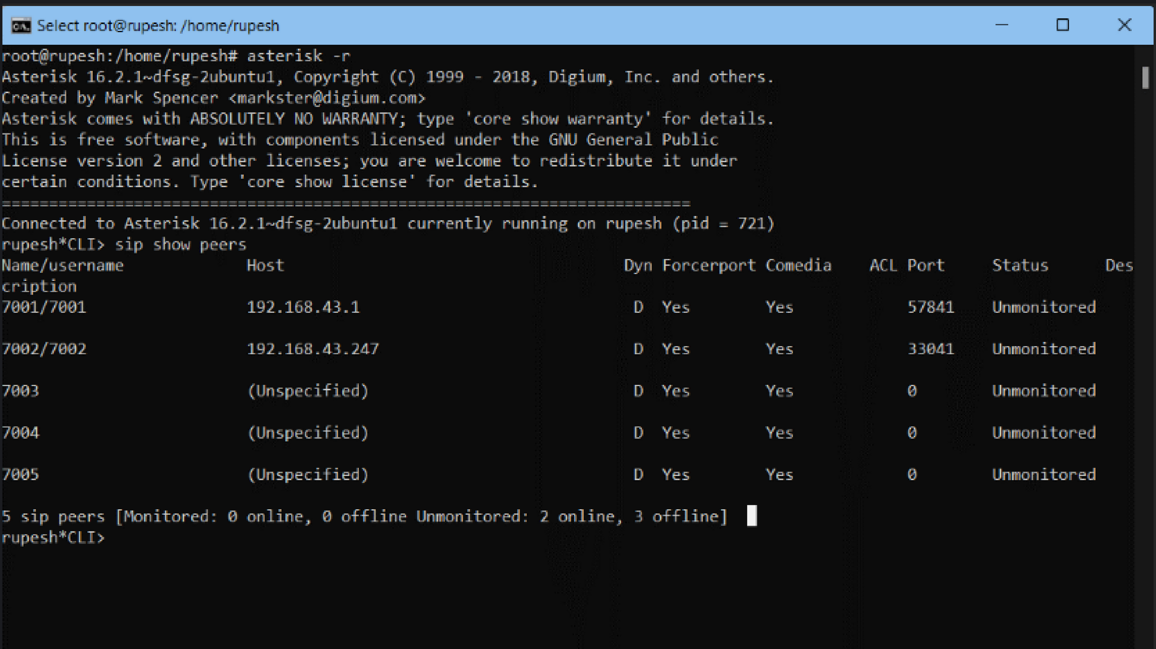

Slide 18
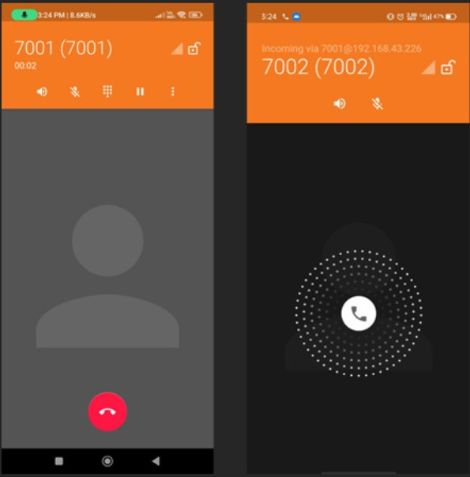

Slide 19
Research Paper Status
Research Paper - 100% Completed
Research Paper Submitted to Conference
Patent Status
Patent Draft Submitted

Slide 20
Testing Report
Hyperlink of the report -
https://docs.google.com/document/d/14Kzs0u2LsHUeJq38622w43sVBDGES0f9/edit?usp=drivesdk&ouid=100234642450988807729&rtpof=true&sd=true

Slide 21
References
[1] Muntaka, Siddique Abubakr & Hussein, Faiza & Sarfo, Paul. (2019). Implementation of an IP Telephony System Based on Asterisk PBX; A Case Study of Garden City University College, Ghana. International Journal of Computer Applications. Volume 177. 975-8887. 10.5120/ijca2019919743.
[2] Megha S Meshram, Pooja Thakare, Pranali Dandekar. VoIP without SIM calling system using Raspberry Pi for the small business organization, International Journal of Advance Research, Ideas and Innovations in Technology, www.ijarnd.com.
[3] Ahmed J. Aleissa; Sabri N. Shabib; Raied K. Farrash; Salem A. Alturky. "Cloud-Based Phone System.” Volume. Volume. 7 Issue. 5, May - 2022 , International Journal of Innovative Science and Research Technology (IJISRT), www.ijisrt.com. ISSN - 2456-2165, PP :-781-783. https://doi.org/10.5281/zenodo.6626251

Slide 22
[4] Sarwar Khan, Nouman Sadiq, "Design and Configuration of VoIP based PBX using Asterisk server and OPNET platform," 5th International Electrical Engineering Congress, Pattaya, Thailand, 8-10 March 2017
[5] N. R. Nalla, S. S and S. R, "Low Cost VOIP System Incorporation with Raspberry Pi," 2022 6th International Conference on Intelligent Computing and Control Systems (ICICCS), Madurai, India, 2022, pp. 94-99, doi: 10.1109/ICICCS53718.2022.9788353.
[6] S. Konshin, M. Z. Yakubova, T. N. Nishanbayev and O. A. Manankova, "Research and Development of an IP network model based on PBX Asterisk on the Opnet Modeler simulation package," 2020 International Conference on Information Science and Communications Technologies (ICISCT), Tashkent, Uzbekistan, 2020, pp. 1-5, doi: 10.1109/ICISCT50599.2020.9351405.

